Slide 1
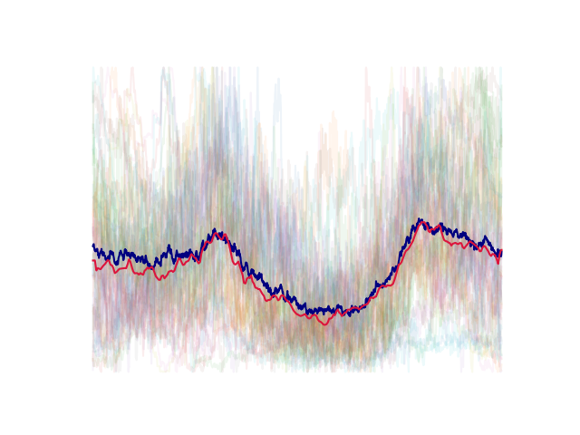
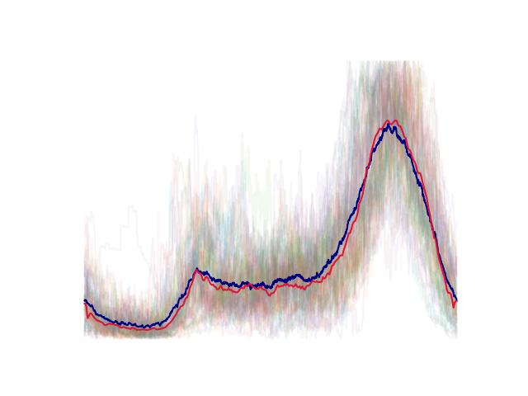
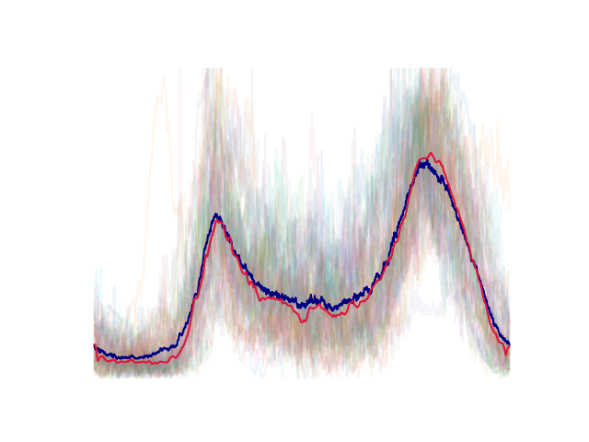
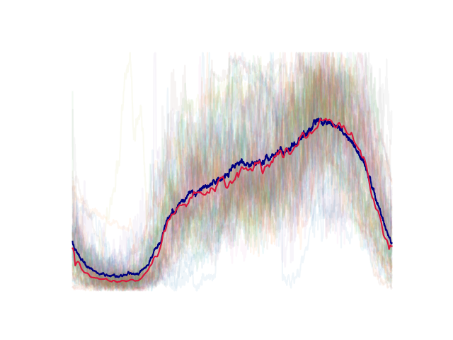
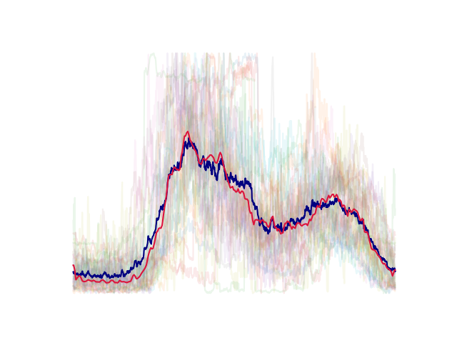
Exploring daily load profile clustering
with Convolutional Autoencoders
Members : Chen Ang
Fu Quanzhi

Slide 2
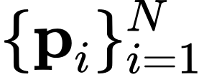

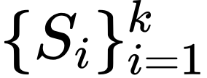
Problem formulation
Given: Average daily load profiles of residents, all normalized to [0, 1].
Goal: Find a k-partition of the profiles such that similar profiles are clustered into the same set.

Slide 3
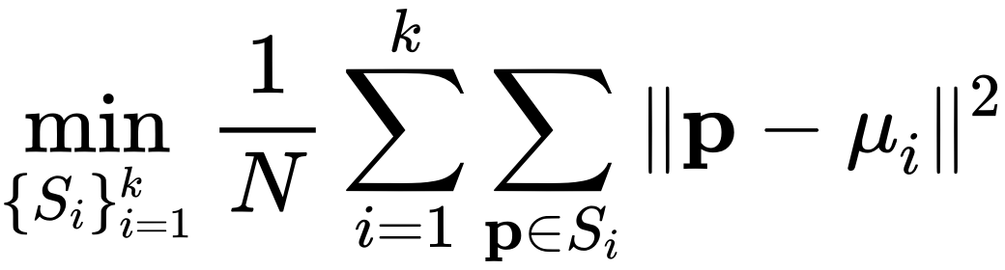
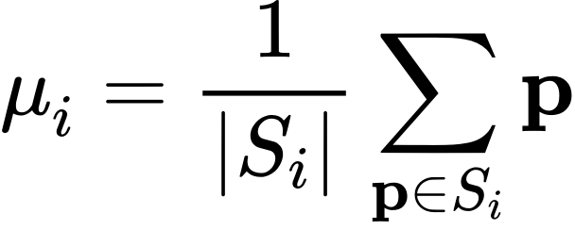
Problem formulation
Given: Average daily load profiles of residents, all normalized to [0, 1].
Goal: Find a k-partition of the profiles such that similar profiles are clustered into the same set.
How to measure similarity?
K-means algorithm?

Slide 4
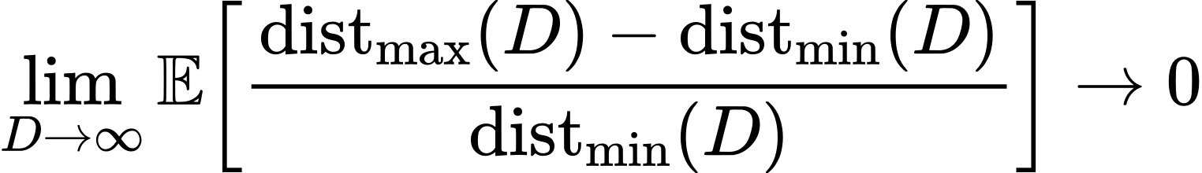
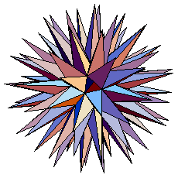
Curse of dimensionality
(Beyer, Goldstein, Ramakrishnan, Shaft)
high dimensionality
(in our case, D = 1440)

Slide 5
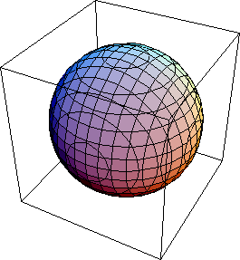
Curse of dimensionality
(Beyer, Goldstein, Ramakrishnan, Shaft)
Dimension reduction
high dimensionality
(in our case, D = 1440)
low dimensionality
(d = 3)

Slide 6
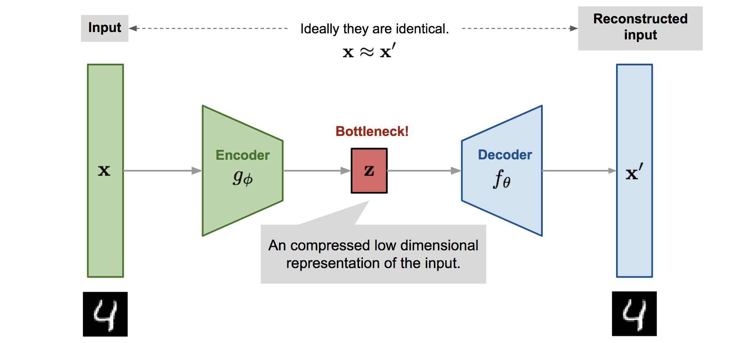
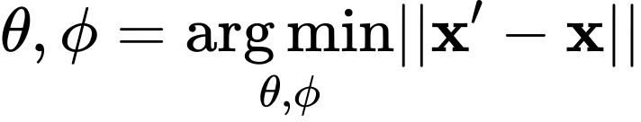
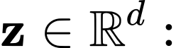
Autoencoder
low dimensional latent variable.
A generic autoencoder

Slide 7
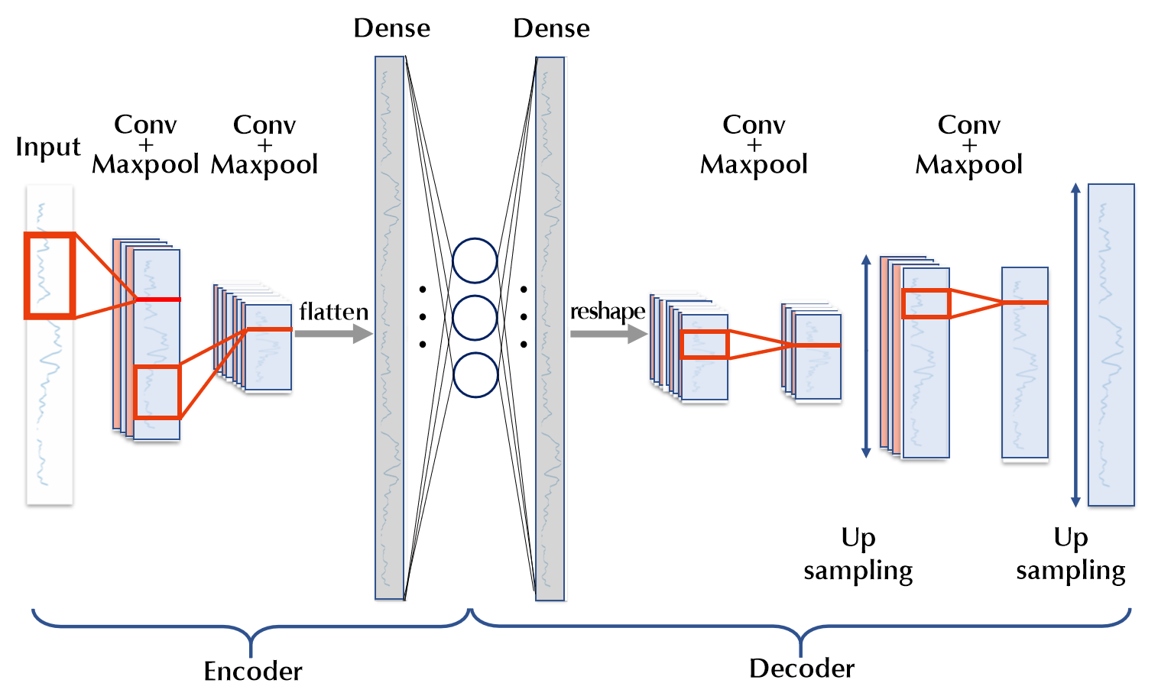
Architecture of our autoencoder

Slide 8
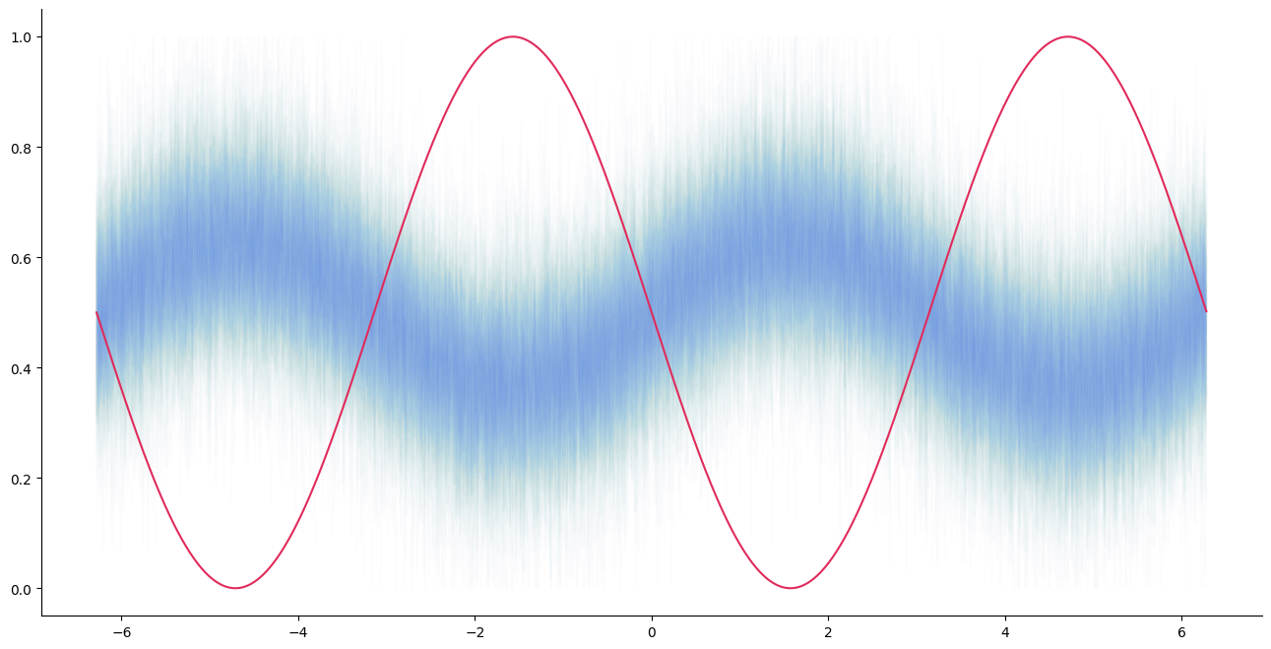
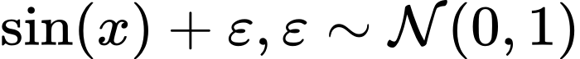
Experiments with sinusoidals
Cluster #1 (N = 100):
Cluster #2 (N = 1):

Slide 9
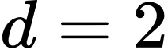
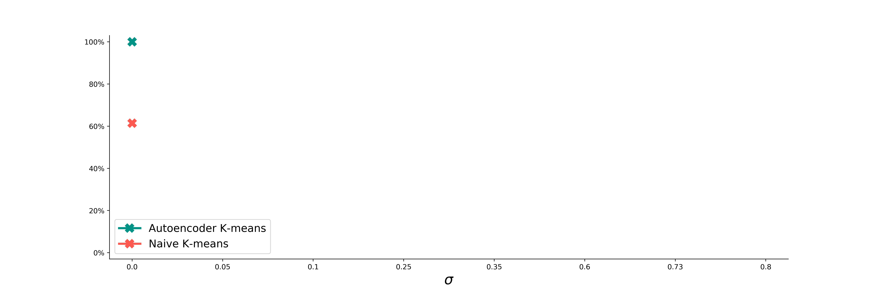
Success rates of clustering:
Naive K-means vs. Autoencoder ( )

Slide 10
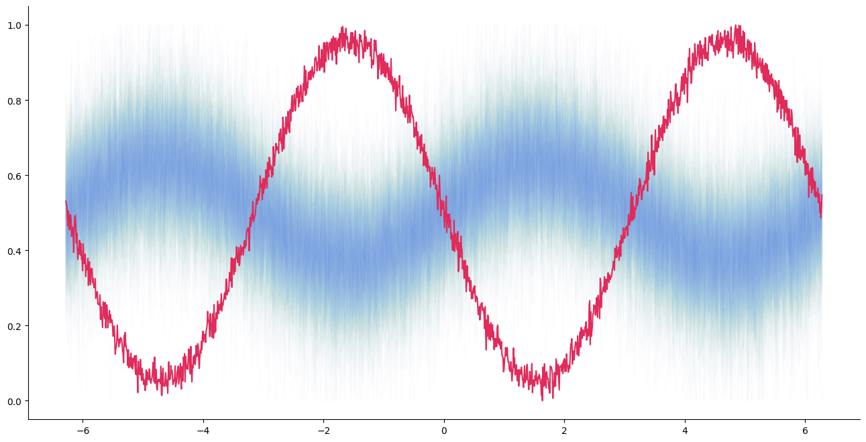
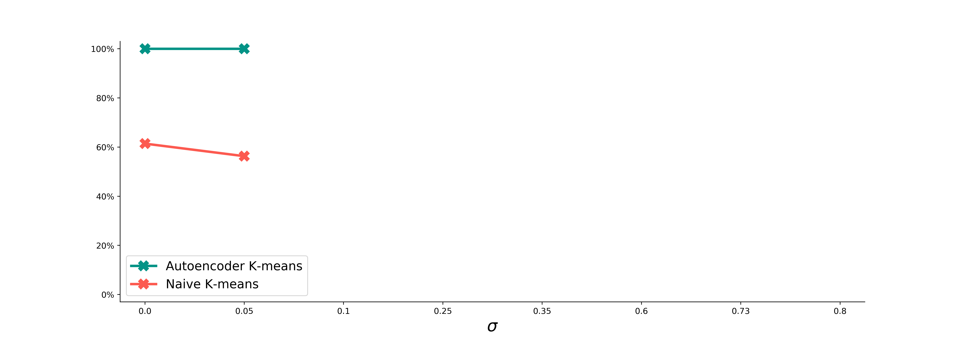
Success rates of clustering:
Naive K-means vs. Autoencoder ( )

Slide 11
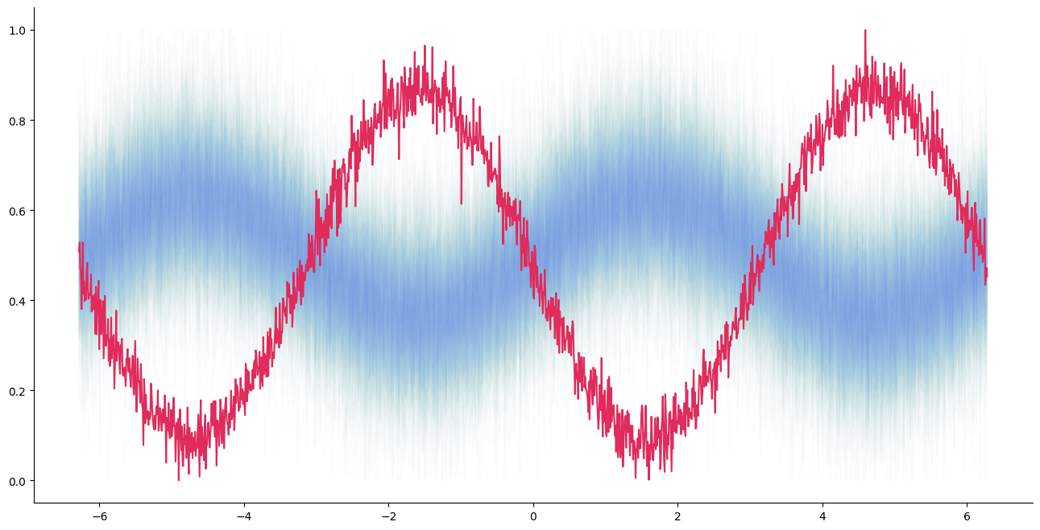
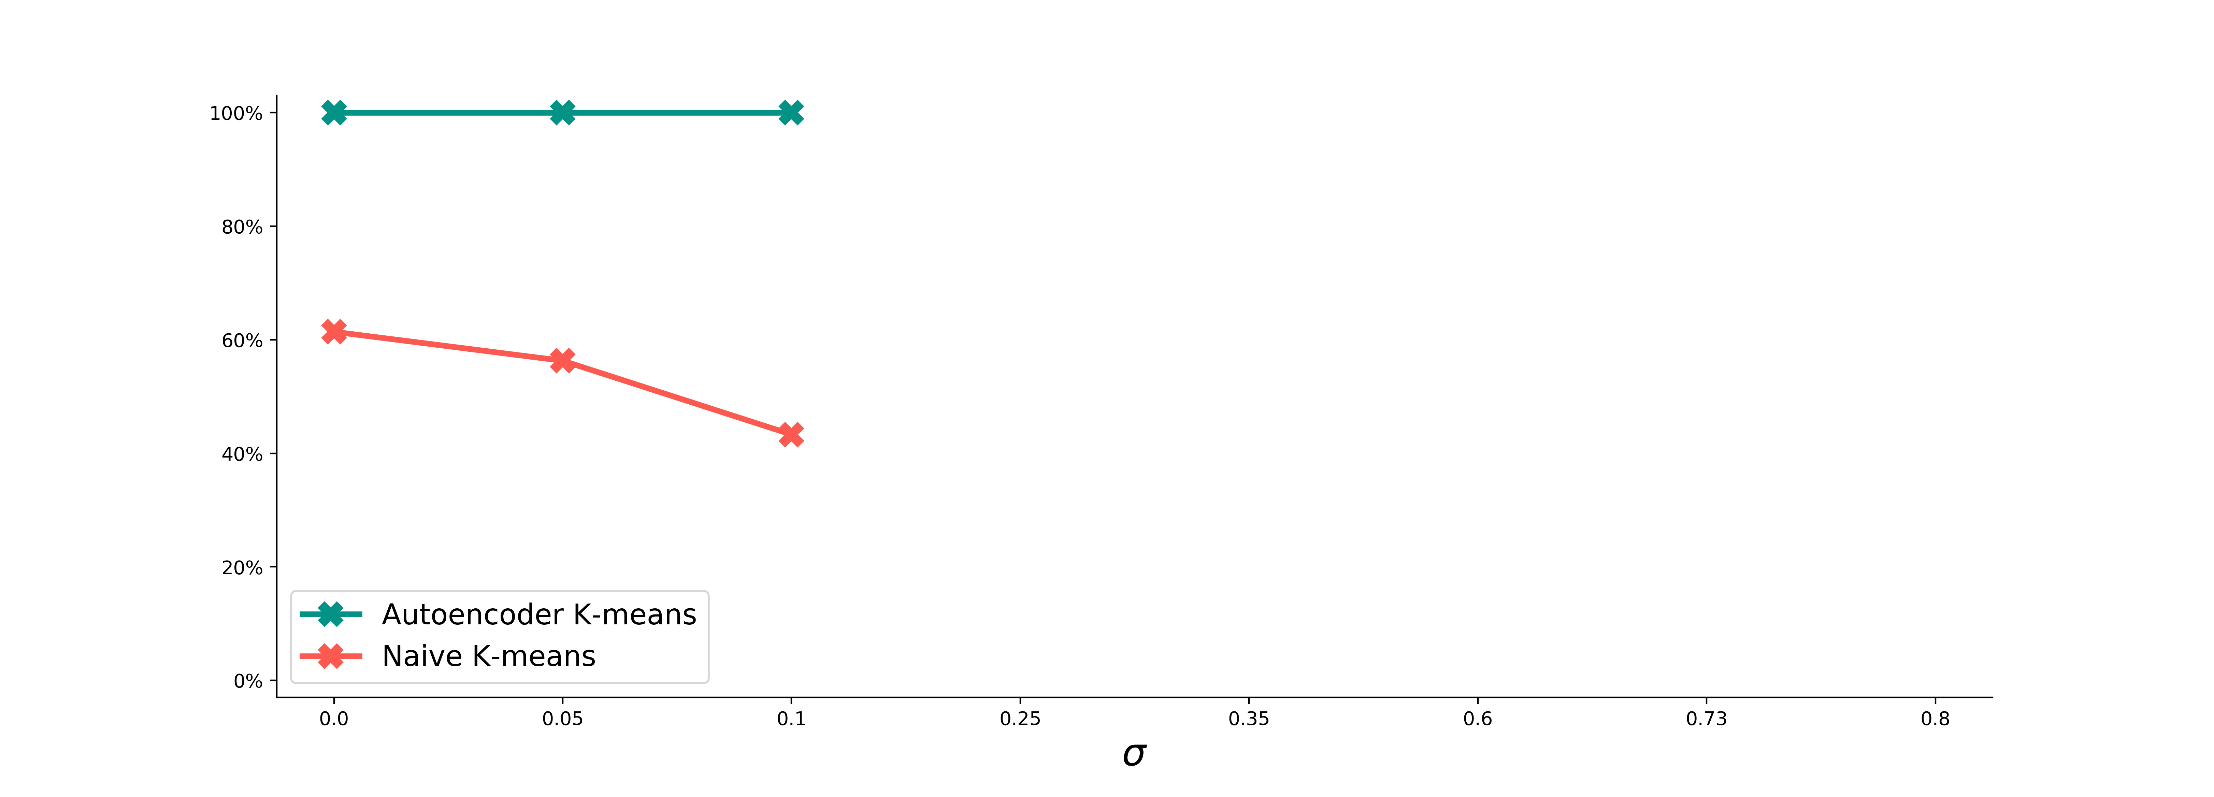
Success rates of clustering:
Naive K-means vs. Autoencoder ( )

Slide 12
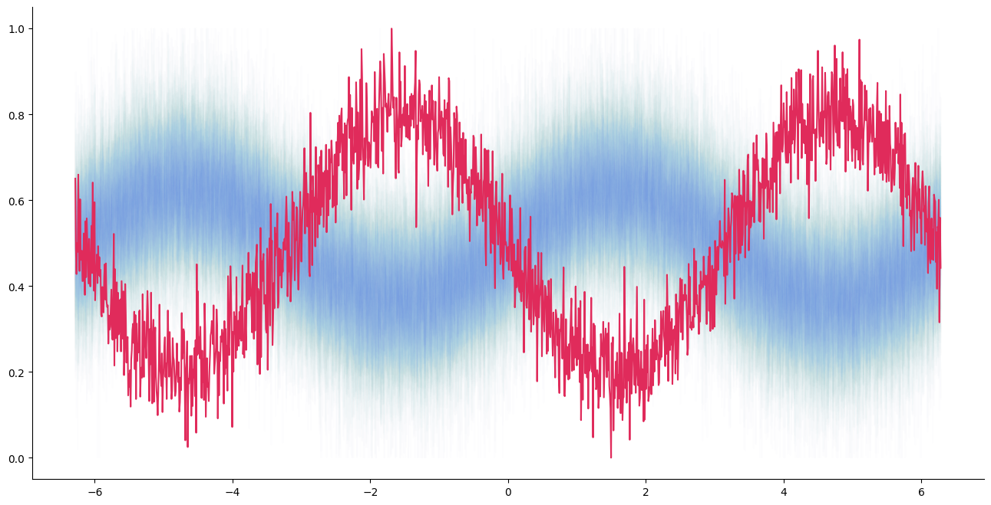
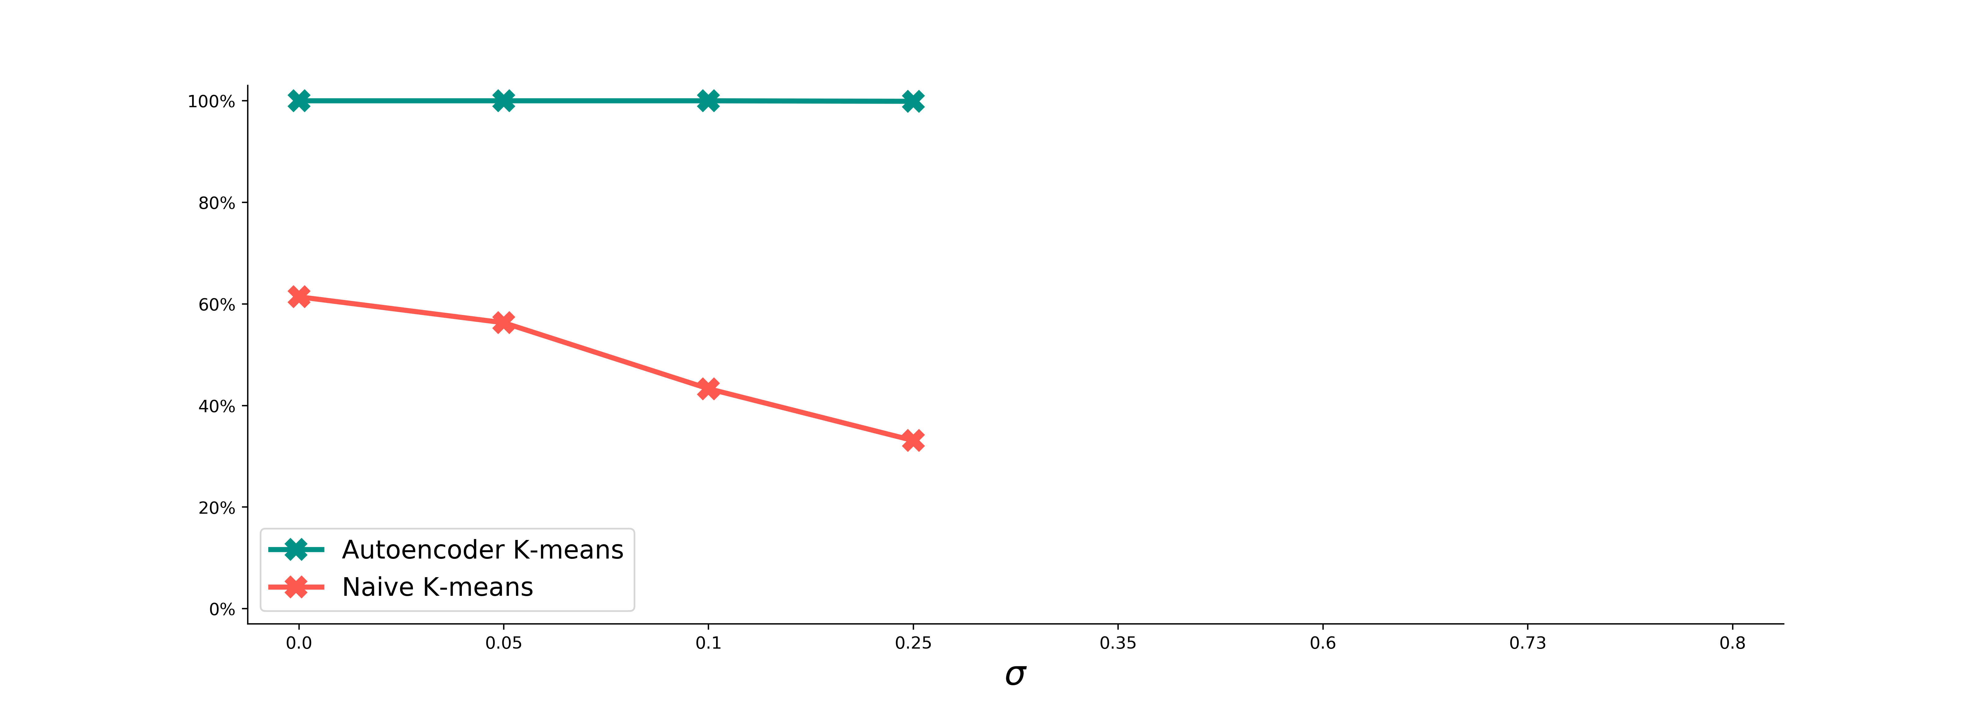
Success rates of clustering:
Naive K-means vs. Autoencoder ( )

Slide 13
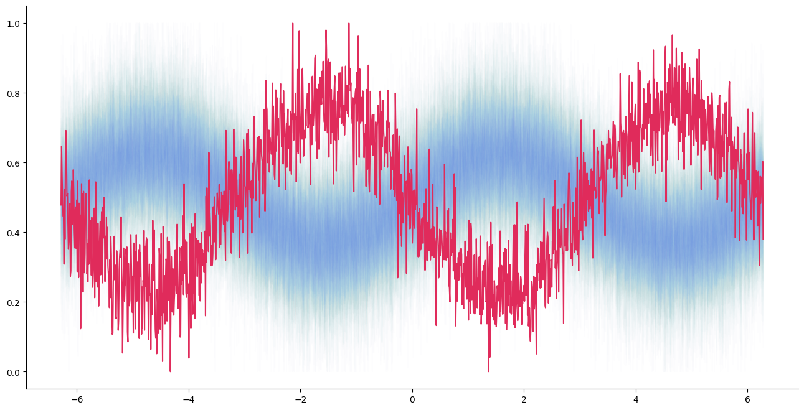
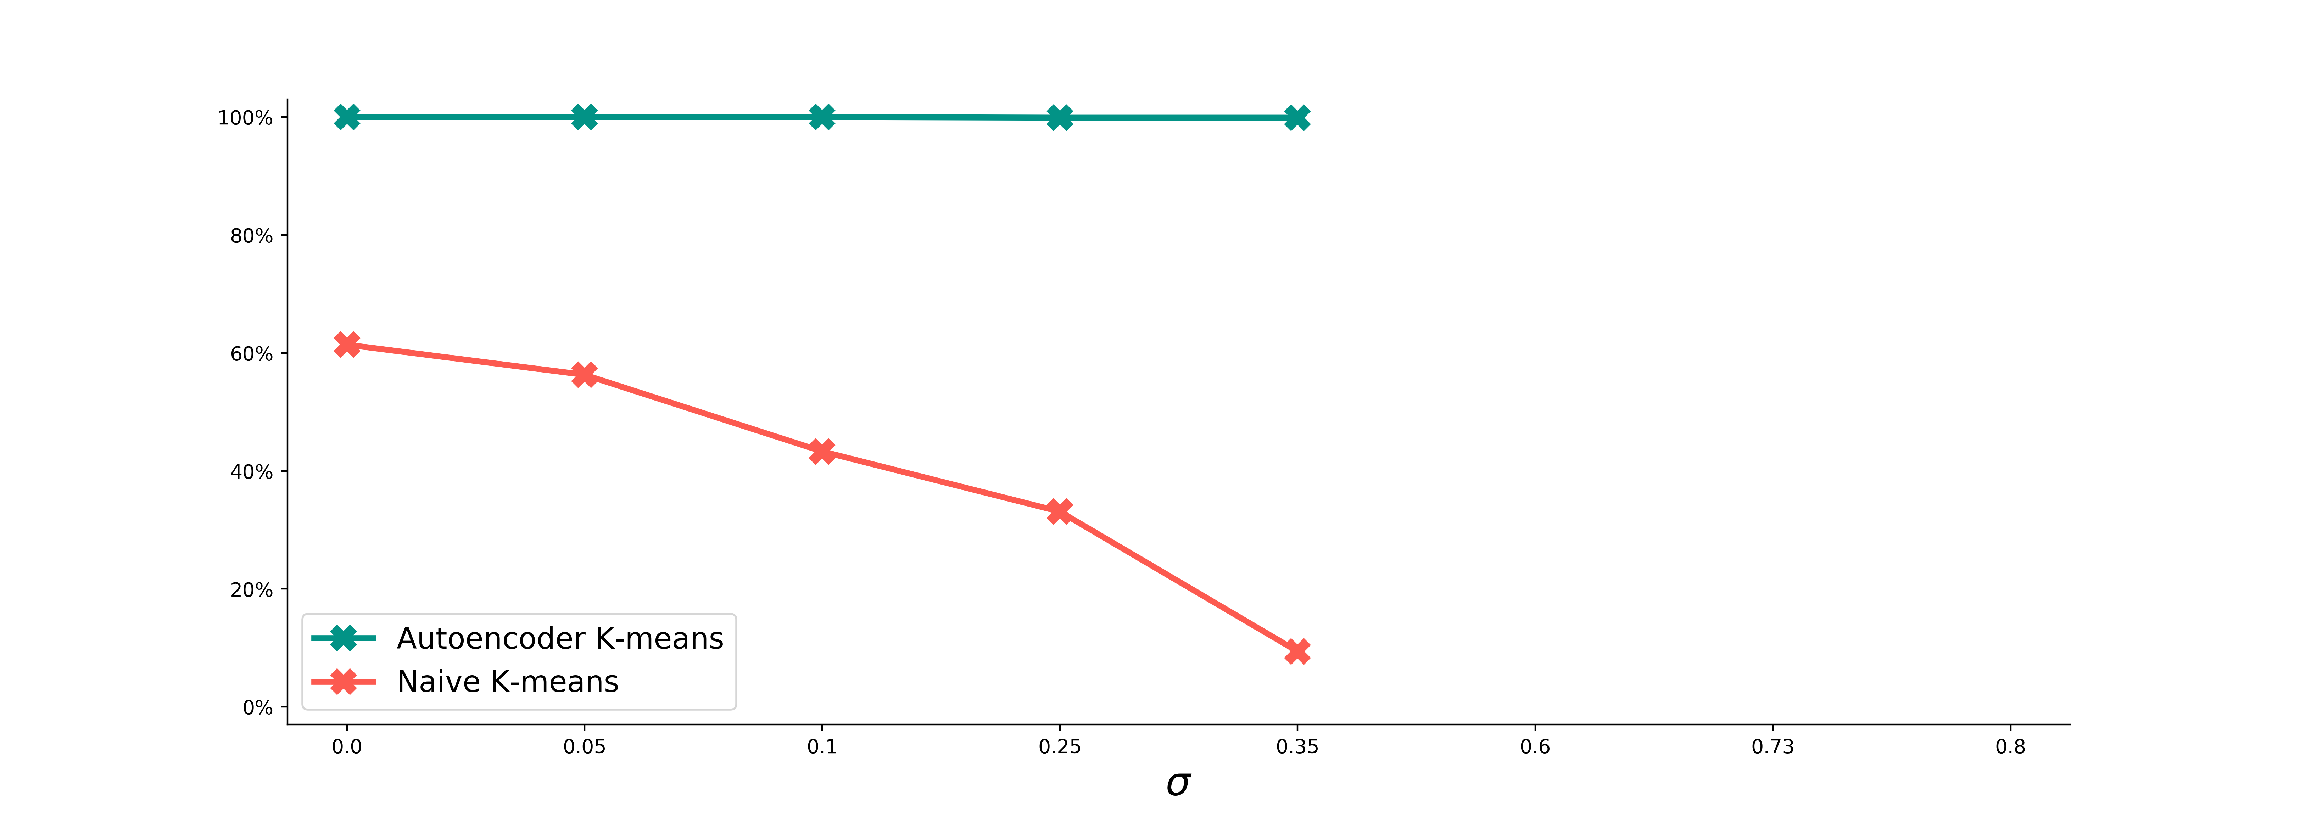
Success rates of clustering:
Naive K-means vs. Autoencoder ( )

Slide 14
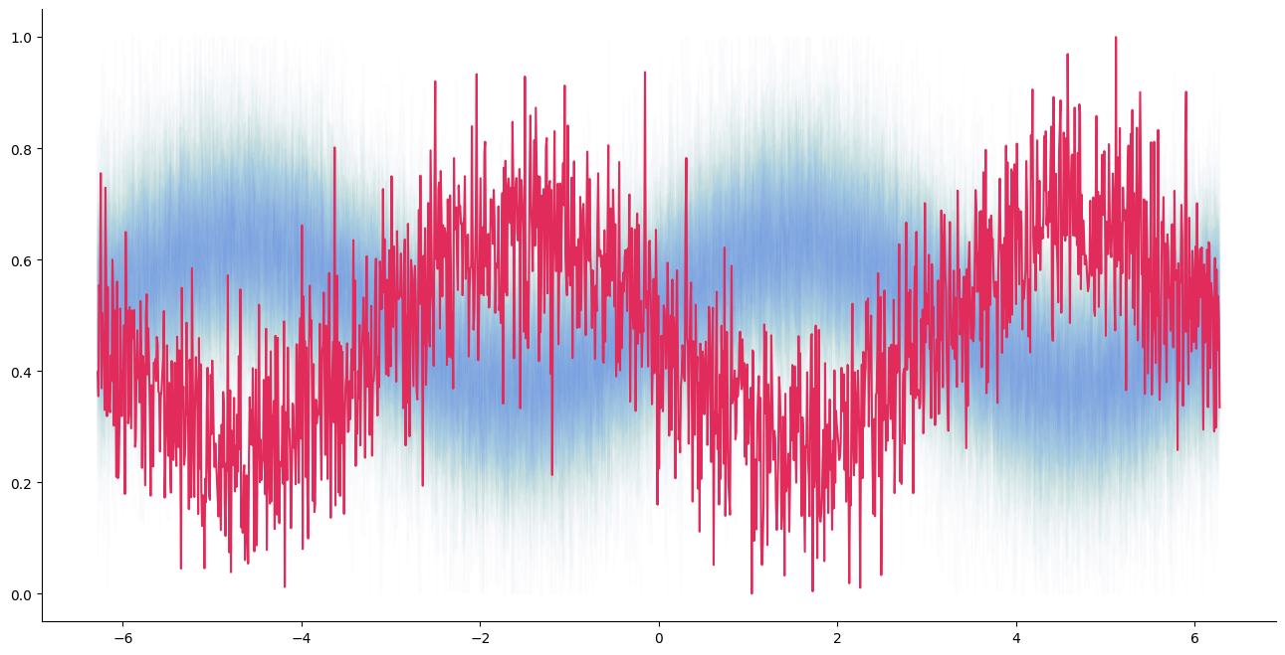
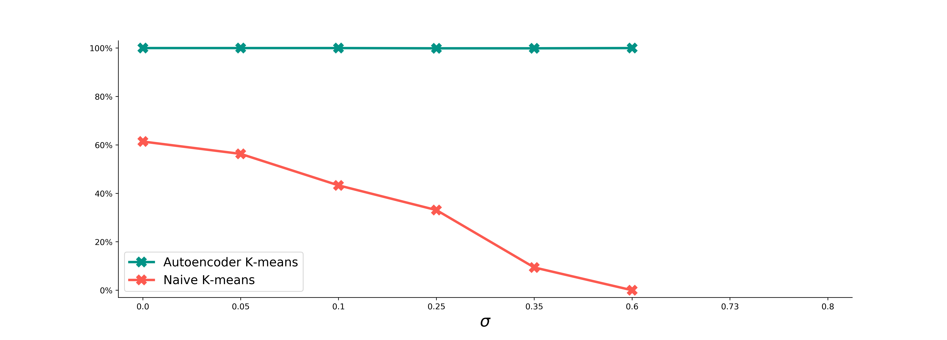
Success rates of clustering:
Naive K-means vs. Autoencoder ( )

Slide 15
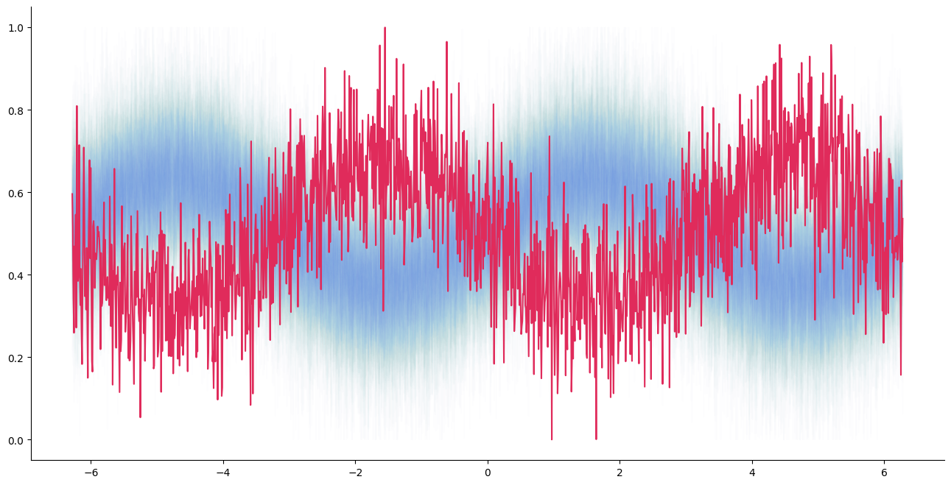
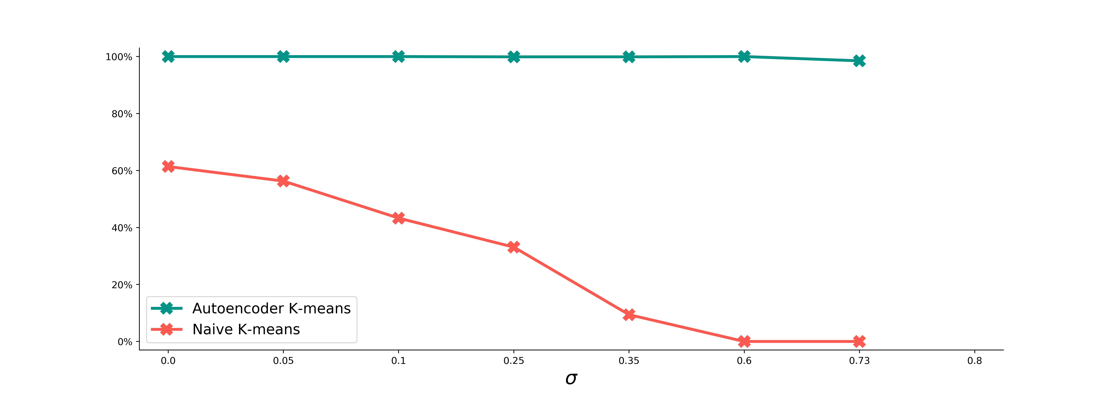
Success rates of clustering:
Naive K-means vs. Autoencoder ( )

Slide 16
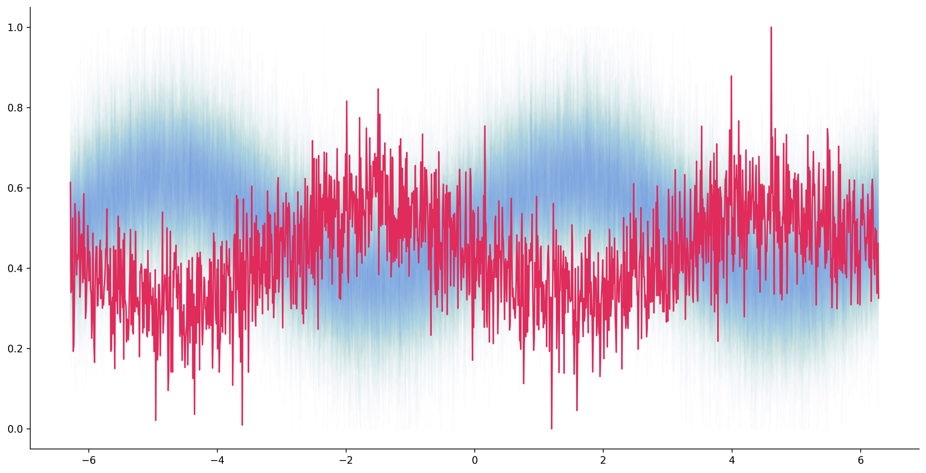
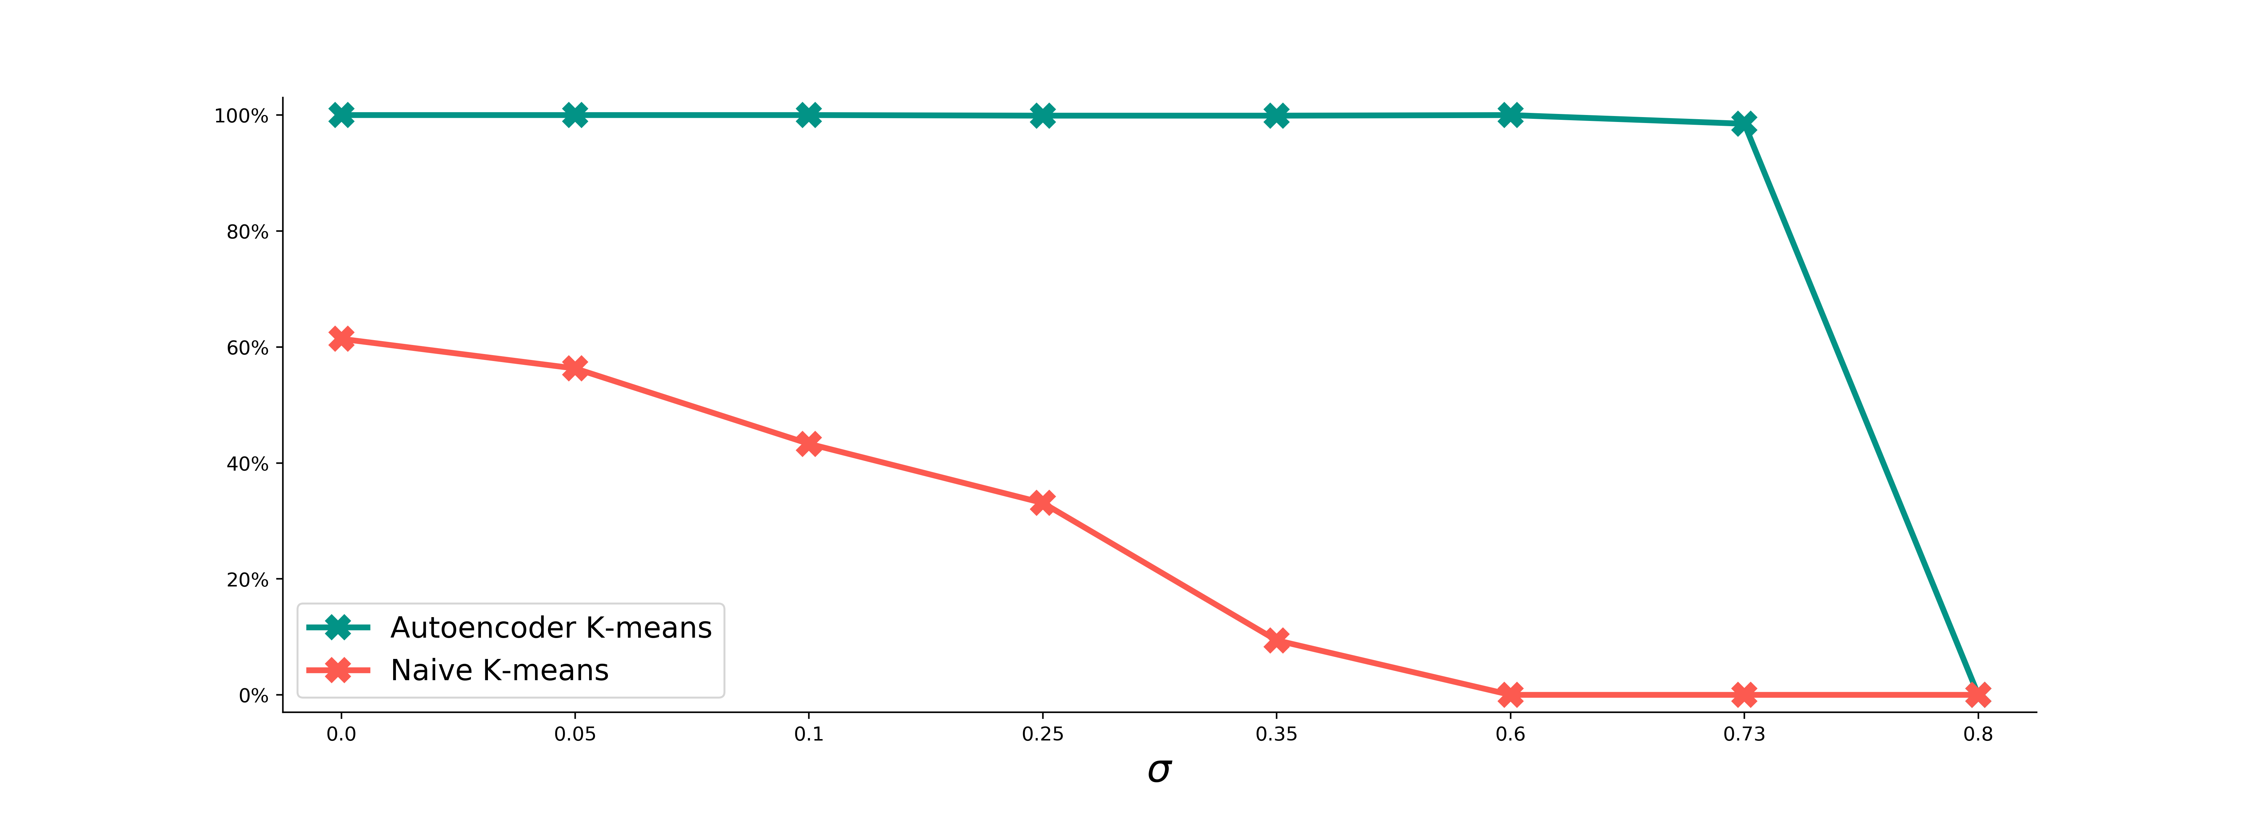
Success rates of clustering:
Naive K-means vs. Autoencoder ( )

Slide 17
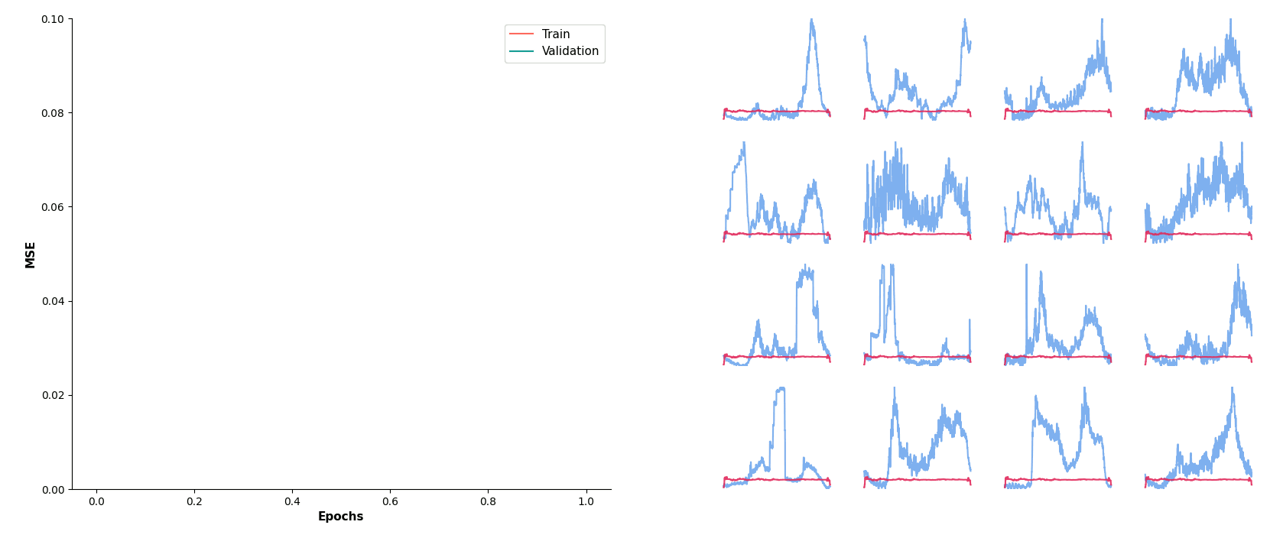
Training dynamics
Reconstruction loss
Reconstructed profiles

Slide 18
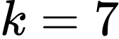
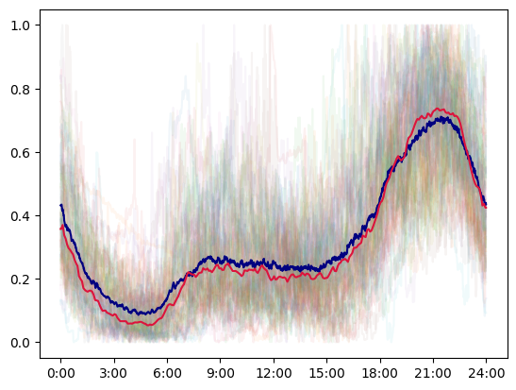
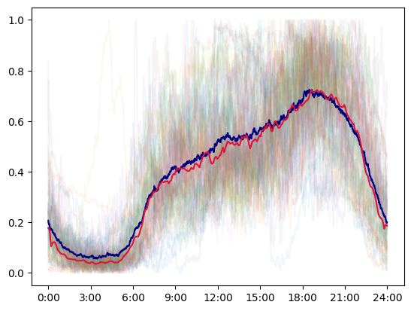
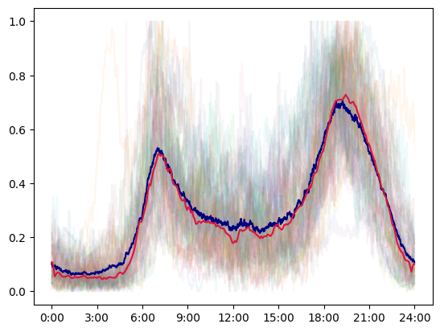
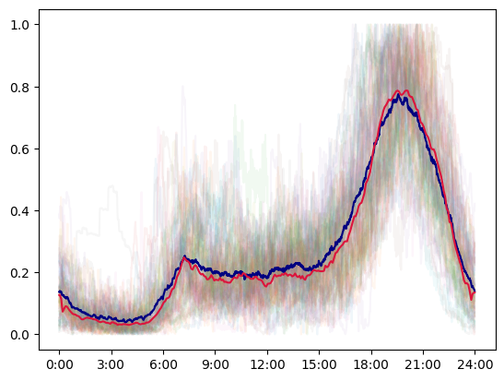
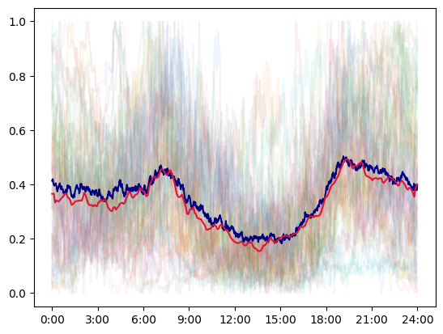
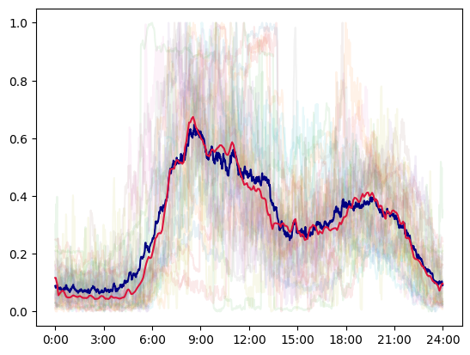
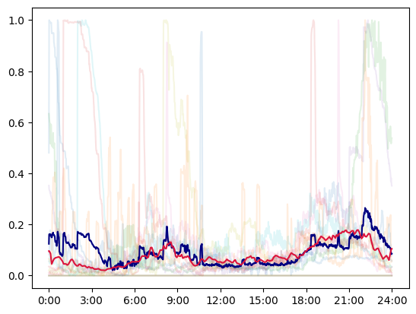
Results ( )
Cluster #1 (67)
Cluster #2 (67)
Cluster #3 (66)
Cluster #4 (42)
Cluster #5 (40)
Cluster #6 (26)
Cluster #7 (14)

Slide 19
How do the results compare against the naive K-means?

Slide 20
How do the results compare against the naive K-means?
Well...

Slide 21
Results comparison
TODO:

Slide 22
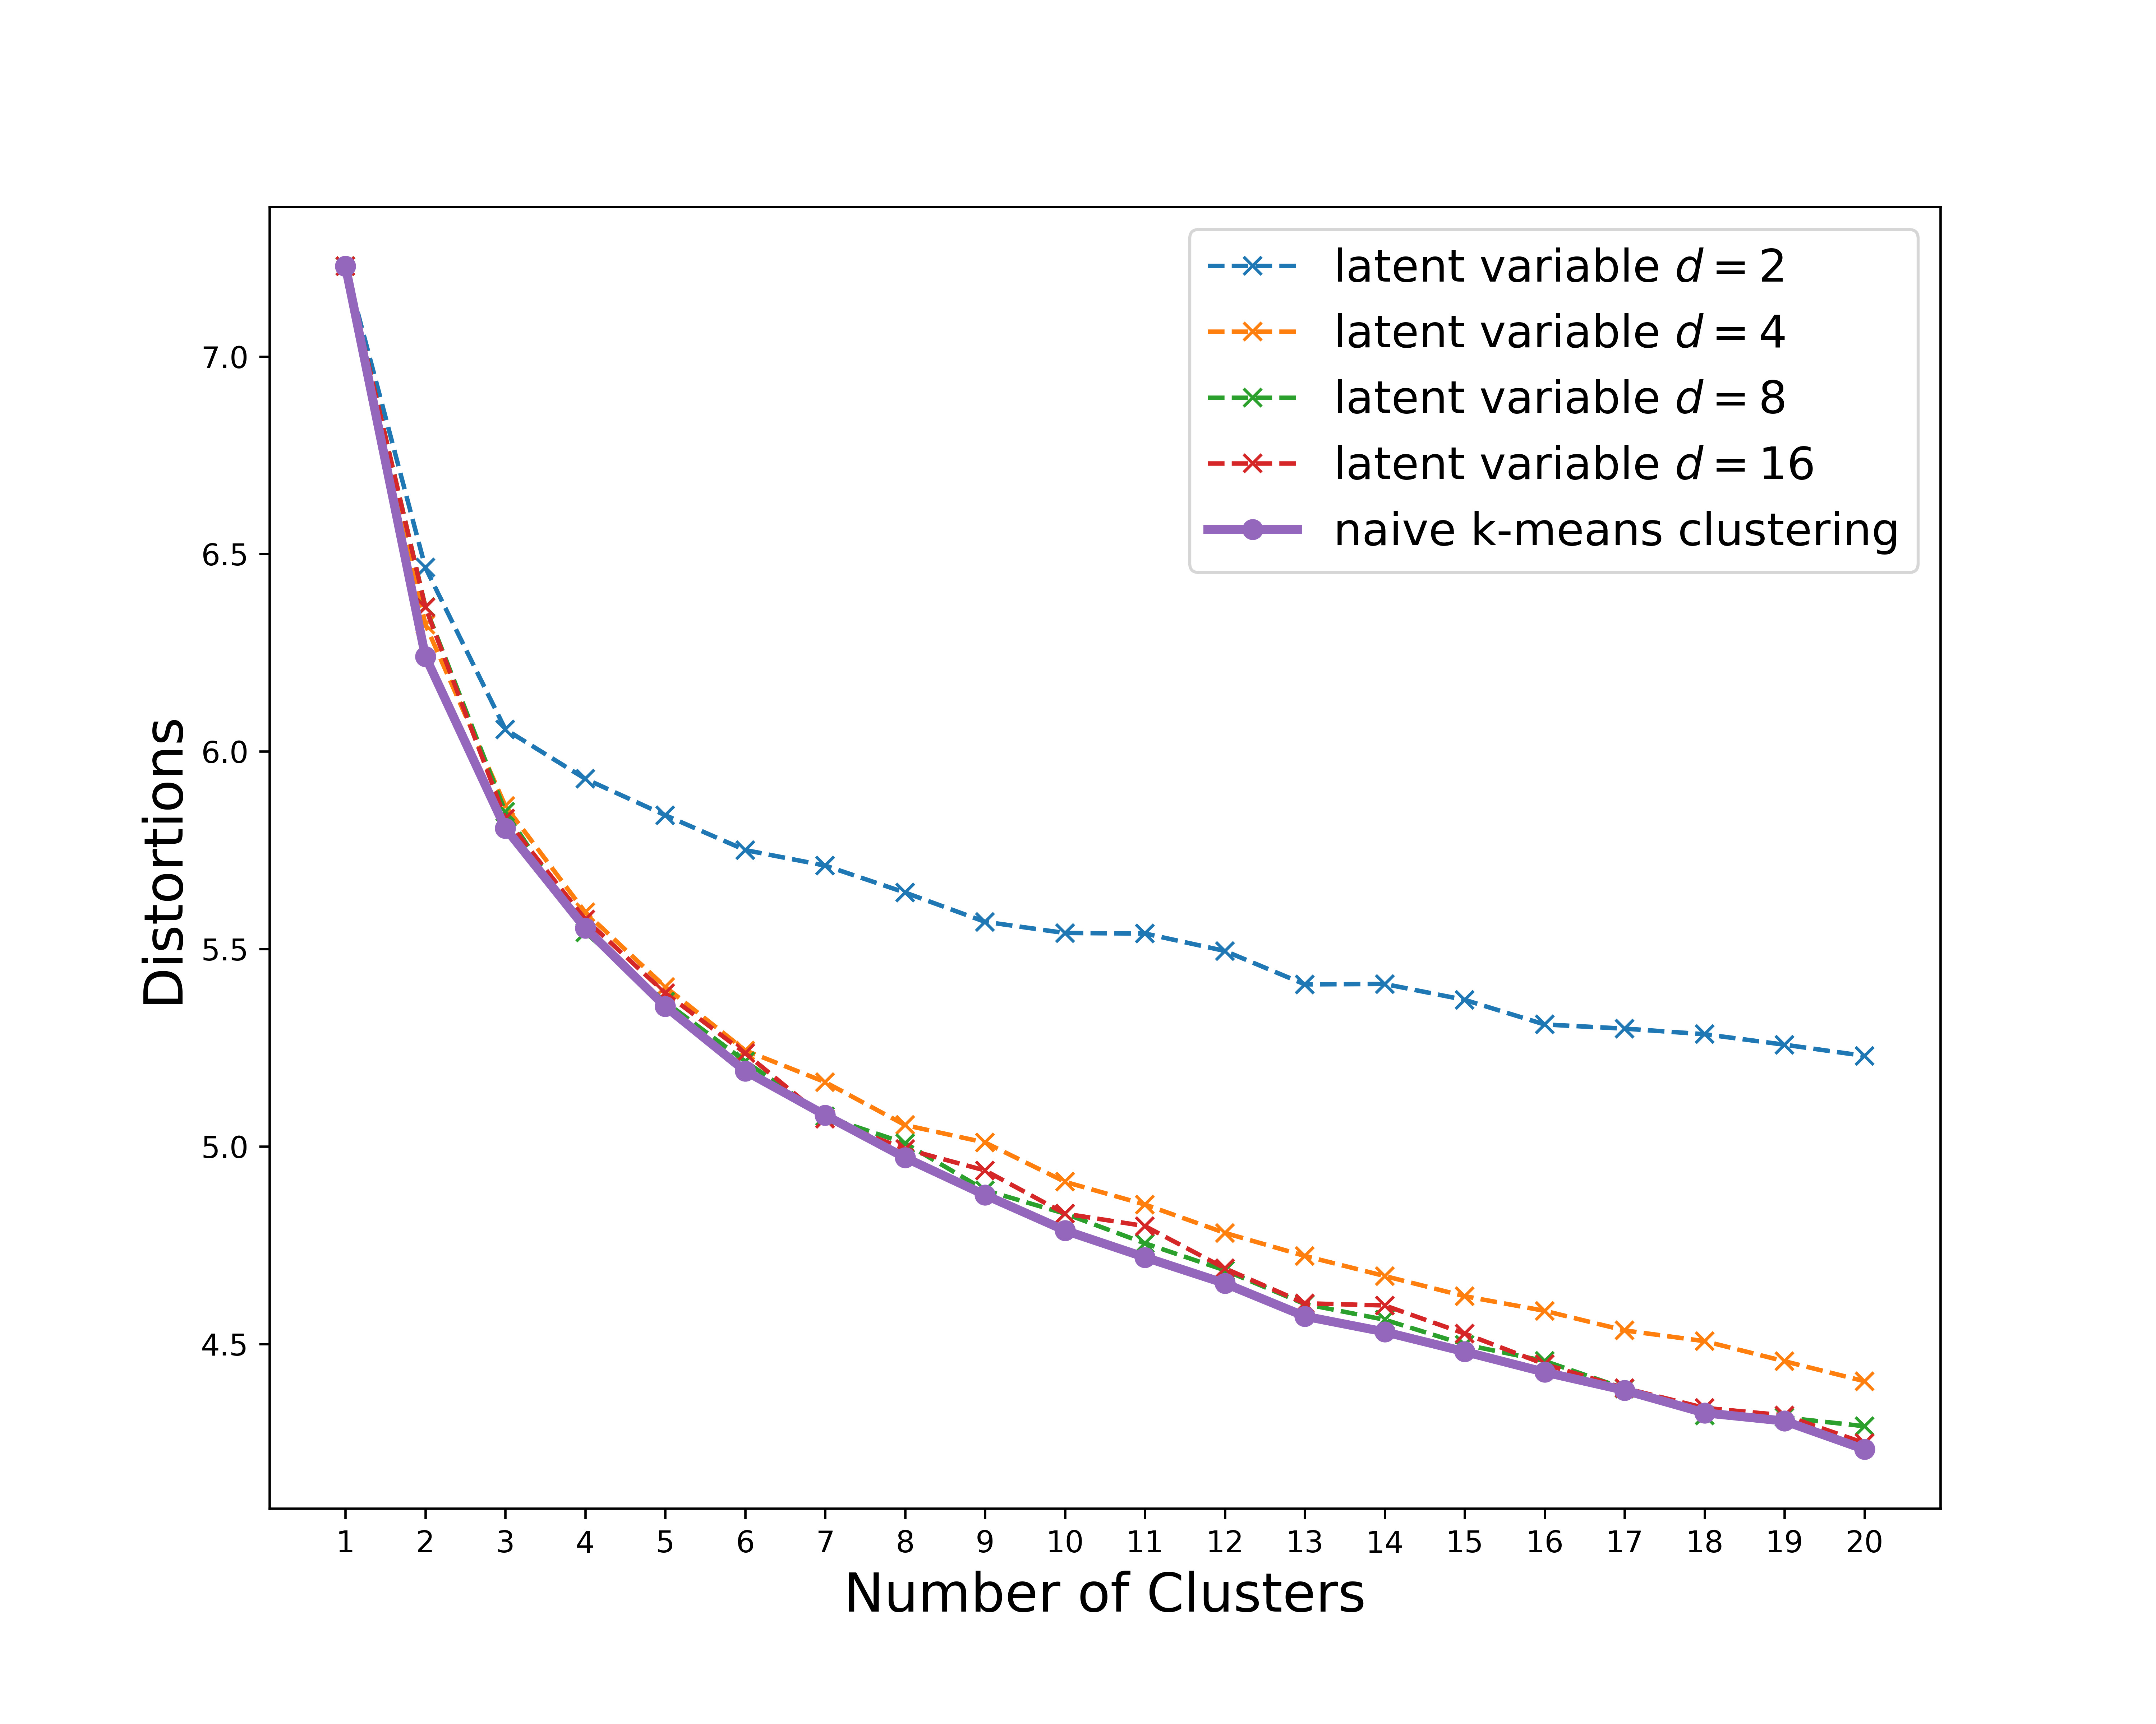
Results comparison (cont'd)

Slide 23
Why?

Slide 24
Curse of dimensionality, revisited
(Beyer, Goldstein, Ramakrishnan, Shaft)

Slide 25
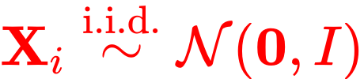
Curse of dimensionality, revisited
(Beyer, Goldstein, Ramakrishnan, Shaft)
given
Load profiles of two residents may not be independent.
Entries (minutes loads) of a profile vector are highly correlated!
Correlations between entries can help avoid the concentration of distances (Durrant, Kabán)

Slide 26
Conclusions
Convolutional autoencoders can be used as an effective means of reducing dimensionality of time series data, and thus alleviating the curse of dimensionality (as shown in our sinusoidals experiments).
However, dimension reduction with autoencoders has not shown to aid clustering algorithms such as K-means on the Pecan Street dataset.
We suspect an origin of such discrepancy to be the inherent (temporal) structures of load profiles. As entries of a load profile are highly correlated, the severity of distance concentration might be mild, causing the naive K-means method to be more stable than expected.

